Slide 1
Data Preprocessing:
Import the necessary libraries and read the data.
Drop any columns that you deem unecessary for analysis.
The following columns need to be converted for further analysis:
(You might encounter Nan values in the above columns. Pandas treats Nan values as float. Please keep that in mind when making the conversions.)
4. Check for missing values and do a mean imputation where necessary.
 | Details | Required output
'Value' | Amount with Euro symbol as prefix and suffix ‘K’ or ‘M’ indicating thousands and millions respectively. | Convert to Float after getting rid of currency symbol and suffix.
'Wage' | Amount with Euro symbol as prefix and suffix ‘K’ or ‘M’ indicating thousands and millions respectively. | Convert to Float after getting rid of currency symbol and suffix.
'Joined' | Year as a string, in some cases complete date as string | Convert to int with only year
'Contract Valid Until' | Date as a string | Convert to datetime type
'Height' | In inches with a quotation mark | Convert to Float with decimal points
'Weight' | Contains the suffix lbs | Remove the suffix and convert to float
'Release Clause' | Amount with Euro symbol as prefix and suffix ‘K’ or ‘M’ indicating thousands and millions respectively. | Convert to Float after getting rid of currency symbol and suffix.

Slide 2
# Null values present in column in percent: df1.isnull().sum()/len(df1)*100 # There are around 93% entries are null in Loaned From column del df1["Loaned From"] # Removing "€" ,replacing "M" with 000000 and "K" with 000 also changing of dtype to float. df1["Value"] = df1["Value"].str.replace("€","").str.replace("M","000000").str.replace("K","000"). str.replace(".","").astype("float") # Removing "€" ,replacing "M" with 000000 and "K" with 000 also changing of dtype to float. df1["Wage"] = df1["Wage"].str.replace("€","").str.replace("M","000000").str.replace("K","000"). str.replace(".","").astype("float") # Extracted year value and changing dtype to float. df1["Joined"] = df1["Joined"].str[-4:].astype("float") # Converting dtype to datetime df1["Contract Valid Until"]=pd.to_datetime(df1["Contract Valid Until"]) # Replacing (') with (.) and converting dtype to float df1["Height"]=df1["Height"].str.replace("'",".").astype("float") # Replacing (lbs) with null and converting dtype to float df1["Weight"]=df1["Weight"].str.replace("lbs","").astype("float") # Converting to Float after getting rid of currency symbol and suffix. df1["Release Clause"]=df1["Release Clause"].str.replace("€","").str.replace("M","000000"). str.replace("K","000").str.replace(".","").astype("float") #Dropping the Null value rows df1 = df1.drop(index=df1[df1["Position"].isnull()].index)

Slide 3
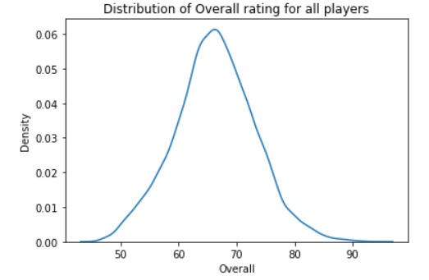
EDA Mini Project
Exploratory Data Analysis:
Plot the distribution of Overall rating for all players.
sns.kdeplot(df1["Overall"])
plt.show()

Slide 4
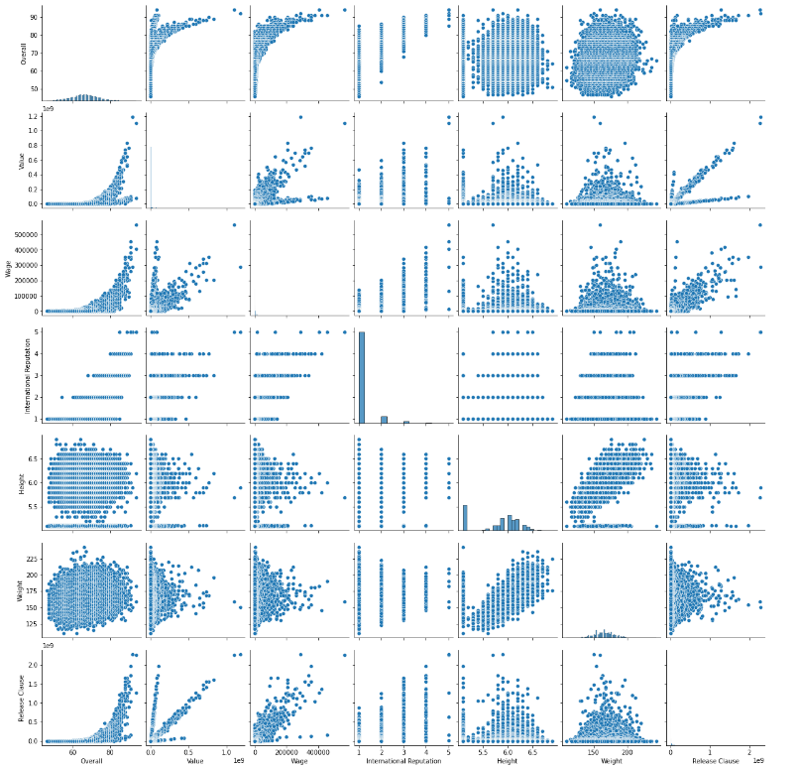
Generate pair plots for the following variables: Overall, Value, Wage, International Reputation, Height, Weight, Release Claus
sns.pairplot(df1[["Overall", "Value", "Wage", "International Reputation", "Height", "Weight", "Release Clause"]])
plt.show()

Slide 5
Generate a table containing the top 20 players ranked by Overall score and whose contract expires in 2020.
df3=df1[df1["Contract Valid Until"].dt.year==2020].sort_values(by="Overall",ascending=False).head(20)
What would the average wage for this set of players be?
print("The average wage for this set of players is",df3["Wage"].mean())
What is the average age?
print("The average age for this set of players is",df3[“Age"].mean())
Is there a correlation between the Overall rating and Value for these players?
print("The correlation between the variables Overall rating and Value for these players is",df3["Overall"].corr(df3["Value"]))
Generate tables containing the top 5 players by Overall rating for each unique position.
df4 = df1.groupby("Position").head().sort_values(["Position","Overall"],
ascending=[True,False])
Are there any players appearing in more than one Table. Please point out such players.
df4[df4.duplicated()]
What is the average wage one can expect to pay for the top 5 in every position?
print("The avgerage wage one can expect to pay for top 5 in position are:")
df4.groupby("Position")["Wage"].mean()

